Slide 1
Income Tax Calculator
Simple income tax calculator using python

Slide 2
Project Description
A Python-Based Income Tax Calculator
Graphical User Interface (GUI):
It utilizes the Tkinter library.
User Input:
Age, time frame selection, and salary.
Calculation:
Dynamically computes income tax.
Detailed Breakdown:
Provides a breakdown of tax amounts for various income brackets.

Slide 3
Tutorial/Material Used
Learning Resources
YouTube Tutorials:
Python GUI Programming with Tkinter - Tutorial
Building GUI Applications with Tkinter and SQLite
GeeksforGeeks Articles:
Introduction to Tkinter
Python Tkinter - Adding Labels
Python Academy:
Complete Python Tkinter GUI Course
Beginner Ideas for Python:
50 Python Project Ideas for Beginners

Slide 4
Customizations Made
User Interface:
Custom styling for visual appeal.
Improved layout for better user experience.
Ensured responsiveness across different screens.
Algorithm:
Enhanced tax calculation efficiency.
Improved calculation accuracy.
Enabled dynamic user input adjustments.
Features:
Additional input options for users.
Detailed tax breakdown for income brackets.
Smooth user experience with custom error handling.

Slide 5
List of things learned from this project
Graphical User Interface Proficiency:
Developed expertise in creating visually appealing and user-friendly interfaces using Tkinter.
Algorithm Optimization Skills:
Mastered the art of optimizing algorithms to enhance the efficiency of income tax calculations.
User-Centric Design Approach:
Adopted a user-centric design philosophy, focusing on responsive layouts and dynamic user input handling.
Enhanced Error Handling:
Implemented robust error-handling mechanisms for a seamless user experience and effective troubleshooting.
Project Planning and Execution:
Successfully planned and executed a software project from inception to completion, gaining valuable project management skills.

Slide 6
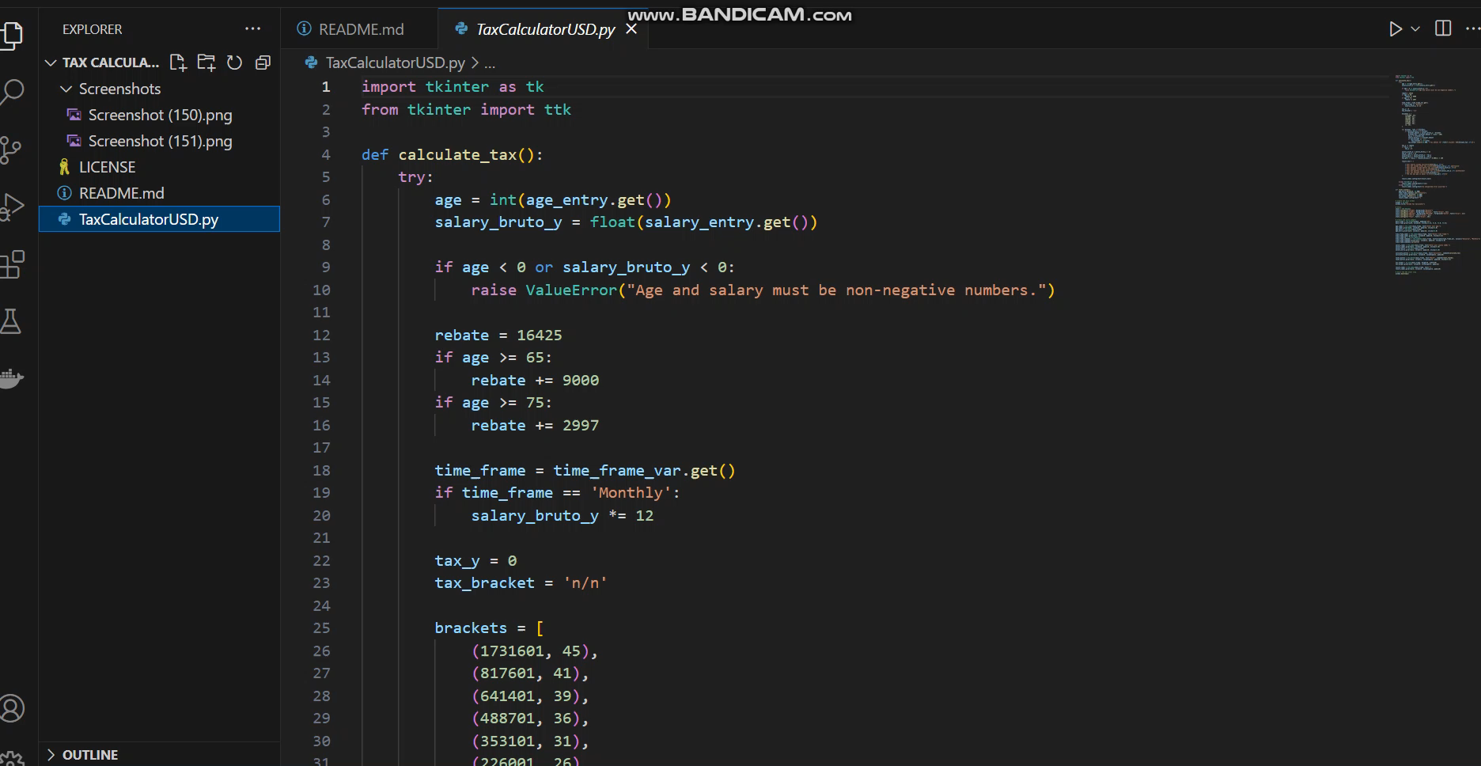
Project Overview and Demonstration
Video 1: Getting Started with the Income Tax Calculator
This video shows Launching the system and the overview of user interface.

Slide 7
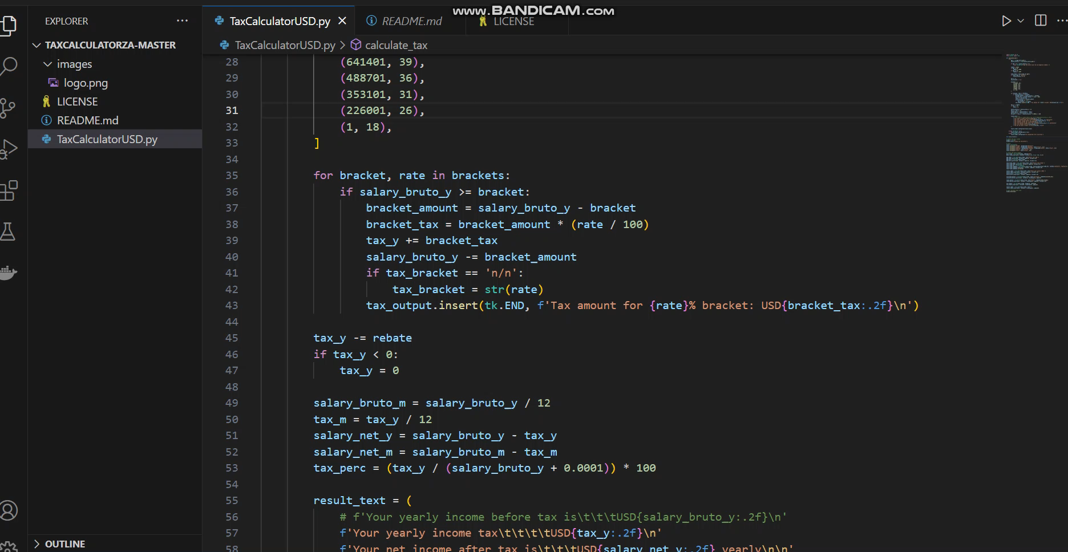
Video 2: User input and system output.
In this case the user enters Age, Time and Salary in Usd and the system calculates and gives the output.

